Slide 1
Mental Health and Wellbeing
Helen herries
Jordan burton

Slide 2
AIMs
To have a clear understanding of the current context surrounding Mental Health and Wellbeing of young people
To have a good understanding of the tools available to support students who have poor mental health

Slide 3
what percentage of children and adolescents have a mental health condition world wide?
Globally, it is estimated that 1 in 7 (14%) 10-19 year-olds experience mental health conditions, yet these remain largely unrecognized and untreated.
Notes:
Mental health of adolescents (who.int)

Slide 4
How many people in England have a mental health condition?
1 in 4 people will experience a mental health problem of some kind each year in England
Notes:
How common are mental health problems? - Mind

Slide 5
How many people in any given week will experience mix anxiety and depression?
8 in 100 people will experience mix anxiety and depression

Slide 6
How many people have suicidal thoughts over the course of their lifetime?
1 in 5 people will have a suicidal thought in their lifetime

Slide 7
Mental health statistics
1 in 6 children aged 6-16 in England had a probable mental health condition in 2021, up from 1 in 9 in 2017.
Current figures are especially concerning for adolescent girls aged between 17 and 19: one in four had a probable mental health condition in 2021.
11 to 16 year olds with a probable mental disorder were less likely to feel safe at school (61.2%) than those unlikely to have a mental disorder (89.2%).
Globally, suicide is the fourth leading cause of death among 15-29 year-olds.
Between 1.25 and 3.4 million people in the UK are affected by an eating disorder
Notes:
Mental Health of Children and Young People in England 2022 - wave 3 follow up to the 2017 survey - NDRS (digital.nhs.uk)
Children and young people’s mental health

Slide 8
Mental health and wellbeing legislation and guidance
Keeping Children Safe in Education (Sept. 2023)
Equality Act 2010
Mental Health and Behaviour in Schools (Nov 2018)
Inspecting safeguarding in early years, education and skills setting (Aug 2021)
SEND Code of Practice (2015)
The Children and Young Person Mental Health Green Paper

Slide 9
Signs of poor mental health
Withdrawn
Behavioural changes
Becoming more extroverted to mask feelings
Avoiding tasks
Fatigue
Lack of personal hygiene/self care
Low attendance
Lack of concentration
Self-harm

Slide 10
What to do if you notice any of the signs
Make note of any unusual behaviours/signs that you have noticed
Report to a Designated Safeguarding Lead
Remember – even the slightest change can indicate a big problem

Slide 11
How are we helping young people with their mental health and wellbeing at gateway college?

Slide 12
Sustaining and building relationships intervention
The focus is around building relationships, challenging themselves, teamwork and cooperation.
Also, a space to step out of their comfort zone and recognise their own success.
Run for 6 weeks on a Wednesday afternoon with two members of the ALS team
1-hour sessions
Referrals can be made through CEDAR, using the ALS section.

Slide 13
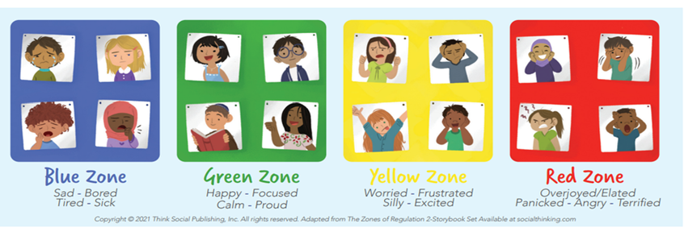
Zones of regulation intervention
A curriculum designed to foster self-regulation and emotional control
Giving students strategies and tools for regulation, prosocial skills and overall wellness
A 6-week intervention on a Wednesday afternoon with two members of the ALS team
45 minutes long
Referrals can be made through CEDAR, using the ALS section.

Slide 14
All about me intervention
For students diagnosed with autism spectrum disorder
Helping students understand their autism diagnosis
1 – 1 basis
3-week intervention
Referrals can be made through CEDAR, using the ALS section.

Slide 15
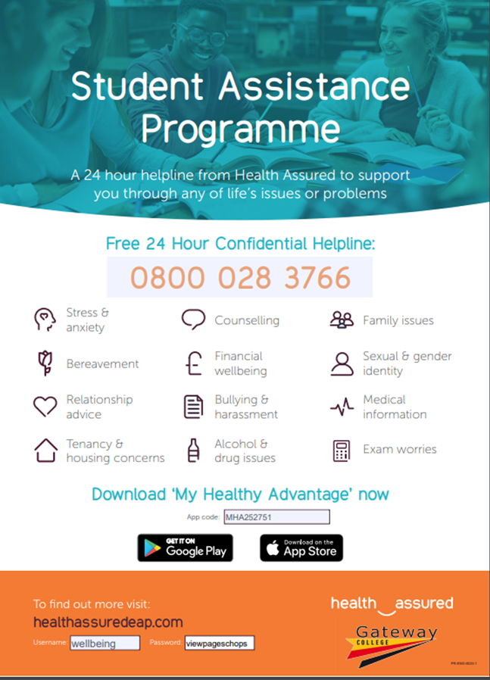
Health assured
New Mental Health and Wellbeing Service for students
Offers a free 24/7 service, with a confidential helpline
Offering face to face and online counselling
A free wellbeing app – My Healthy Advantage
Self referral
For more information see the Mental Health and Wellbeing section on the college website

Slide 17
Padlet
https://padlet.com/ALSGatewayCollege/additional-learning-support-spxp7e3kf9li4hsy

Slide 18
Whole school approach
Mental Health and Wellbeing Strategy
Mental Health and Wellbeing section on the college website
Mental Health Directory
Mental Health and Wellbeing notice boards
Student wellness action plans
Time out cards and first aid cards
Exam support
Mental Health First Aiders
Student Voice

Slide 19
Mental Health first aiders

Slide 20
How can I SUBMIT A SUPPORT REQUEST ON CEDAR?
Using Cedar, search the student you would like to refer
Once on their homepage, click ‘support’ on the lefthand side
Click on study support
Then additional referral

Slide 21
More useful information
The mental health flag on CEDAR
Student support summary on CEDAR
Time out card
Workshop/Wellbeing room – E005
Further information on Pro-Solution web

Slide 22
Notes:
Mental Health: In Our Own Words - YouTube

