Slide 2
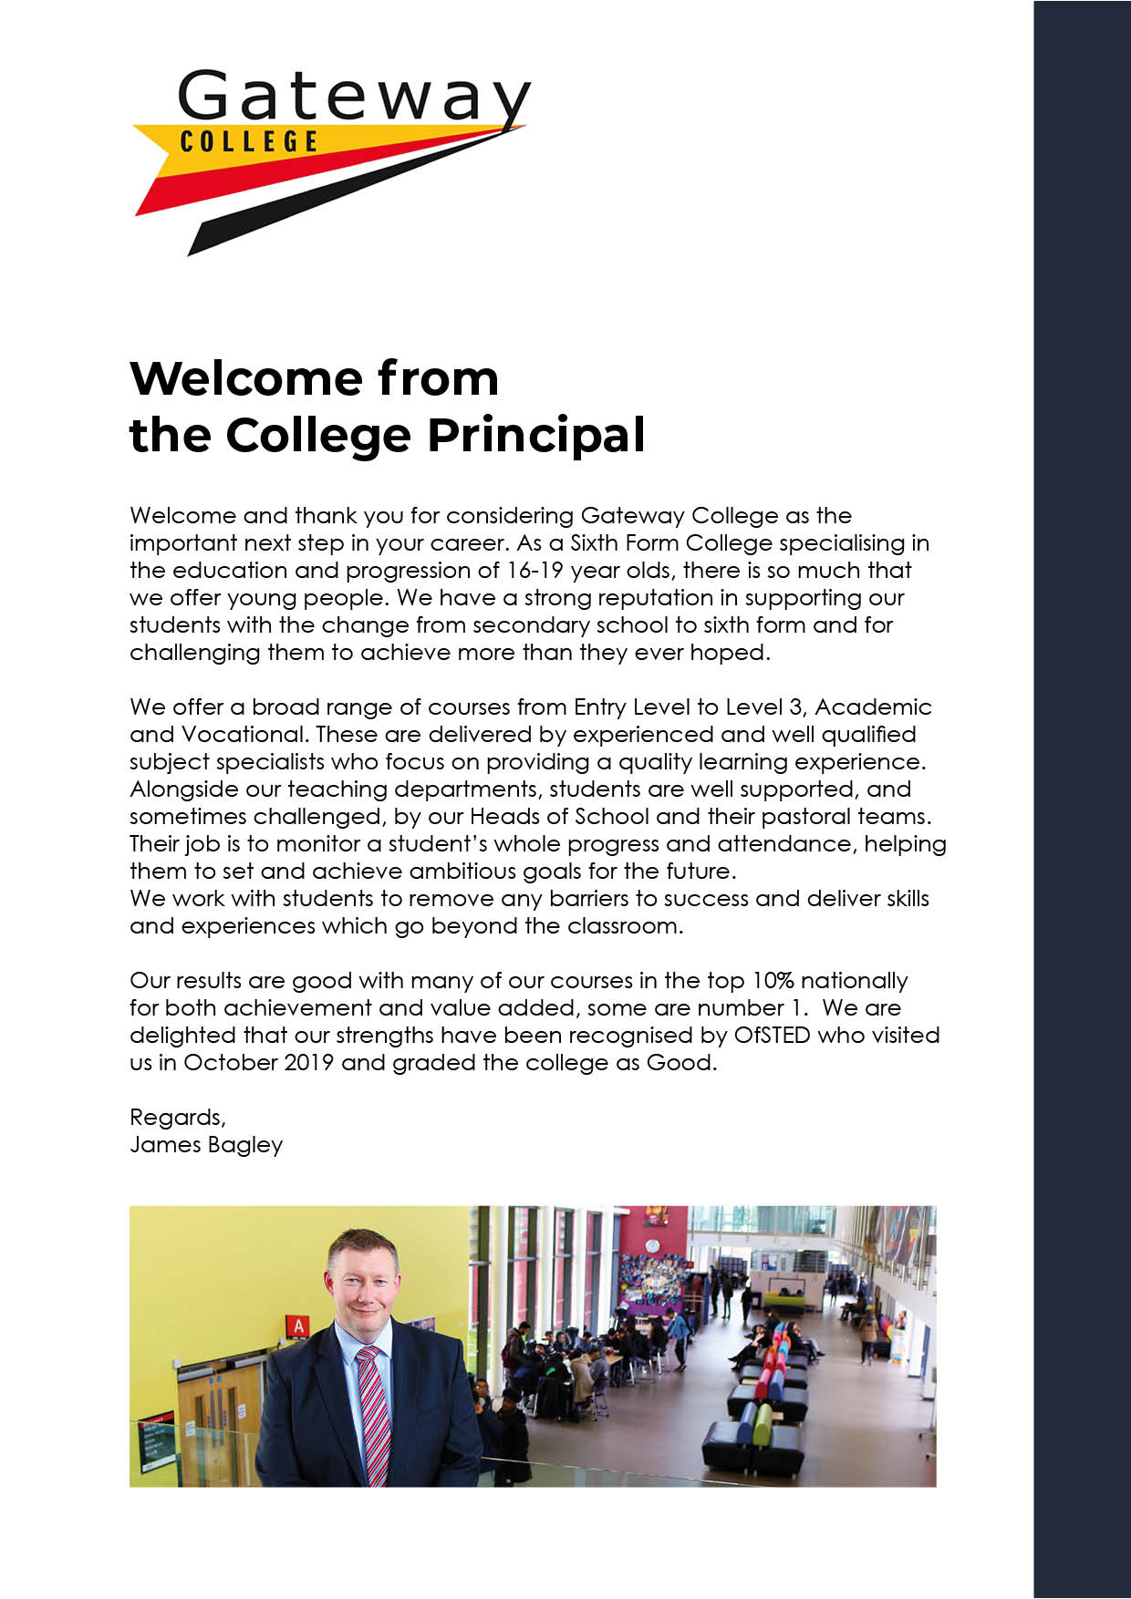

Slide 6
www.gateway.ac.uk

Slide 10
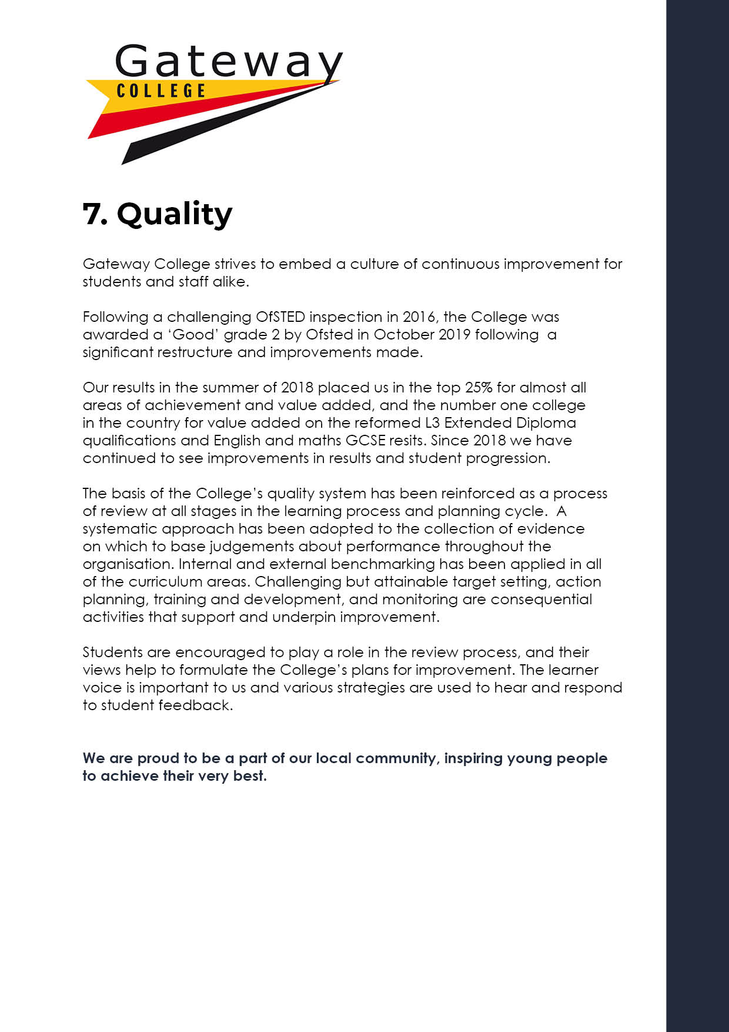

Slide 11
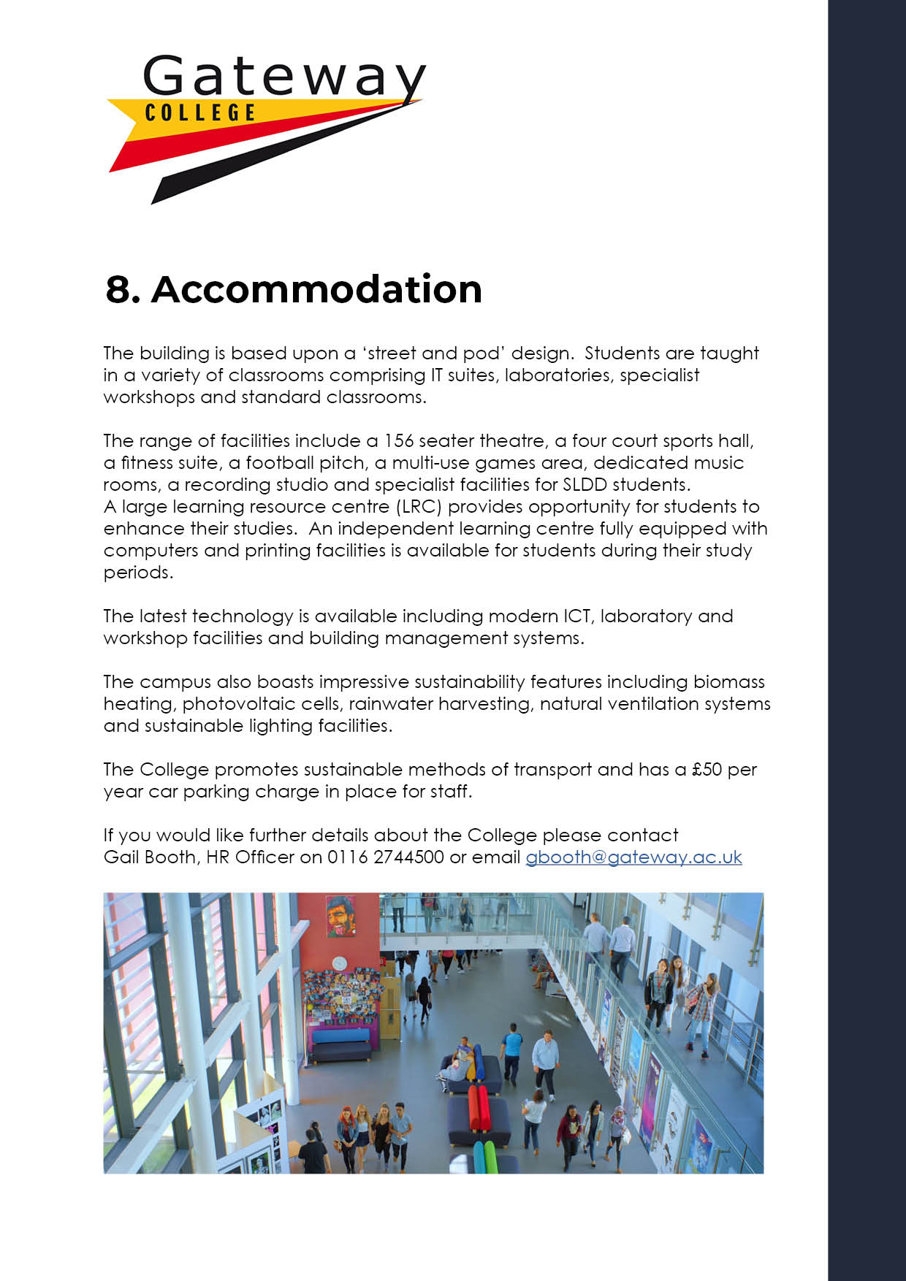
gbooth@gateway.ac.uk

Slide 12
Gateway College is a vibrant sixth form college catering for around 1300 students. In October 2019 Ofsted rated Gateway a good college where the large majority of students are very happy with the education they receive. CURRICULUM and T-LEVEL LEADER FOR IT (Ref: 23/24) We are seeking to appoint an enthusiastic and innovative individual to join our growing IT Department. You will be required to support the Head of IT and Business to lead, develop and monitor the curriculum in Level 2 and 3 IT. For this post, you will need to be an excellent team player, organised, open to new challenges and be confident in all areas of IT. The role is exciting and demanding as a result there are six hours remission to fulfil the positions expectations. The department delivers OCR Level 2 and 3 vocational courses and is already running the Level 2 T-Level Transition programme as well as Year 1 and Year 2 of the Digital Business Services T Level. We are seeking to appoint a dynamic individual to lead, develop and monitor the curriculum to maximise the achievement of all students and development of staff. You must be able to deliver high quality teaching, learning and assessment and continue to produce excellent results, for example 85% of students achieved above their minimum target grade on the Level 3 Foundation Diploma course in 2023. Opportunities for further career development are also available, such as the Aspiring Leaders Course, which enhances the necessary skills and attributes to prepare the staff member for their next career steps. Closing date: Friday 1st December (12 noon) Interview date: Friday 8th December The post is to commence on 8th January 2024 but is negotiable for the right candidate. Employment is under the Sixth Form Colleges contract, 195 days (1265 hours) with the SFCA pay spine £30,500 - £47,133 + Responsibility Allowance £1,223 per annum (pay award pending). Further details and an application pack can be obtained from Teaching and education jobs in LE5 1GA | Tes or by visiting www.gateway.ac.uk.

Slide 13
Reporting to: Head of Department Accountable to: The Principal Tenure: Permanent, 1.0 FTE Salary: Sixth Form College’s Pay Spine Point 1 - 9 (£30,500 - £47,133) plus Responsibility Allowance (£1,223)
Key Purpose
1. | To lead, develop and monitor the curriculum so as to maximise the achievement of all students and development of staff.
Responsibilities
1. | To contribute to the continuous improvement of the learning experience for students
2. | Participate in key College processes as required e.g. enrolment
3. | To participate in appraisal and to undertake staff development activities as appropriate
4. | To work flexibly in the interests of the organisation as required.
5. | To act at all times in accordance with College policies.
Duties and Responsibilities: Curriculum Leaders are responsible to the Head of Department for the organisation and teaching of their subject in accordance with curricular policy laid down by the Principal. The generalised duties and responsibilities laid down in the SFCA Teaching Staff Conditions of Service handbook apply to teaching staff. These should be read in conjunction with this outline job description.
a | To monitor the performance of the students and develop strategies alongside the Head of Department to improve retention, attendance and achievement where necessary.
b | To develop and maintain a close working relationship with the programme team and support staff to plan effective strategies for tackling student underachievement or attendance issues.
c | To develop, implement and monitor strategies to increase the value added achieved by the team.

Slide 14
d | To plan and monitor the development of clear and comprehensive schemes of work and high quality assignments for all of the curriculum programmes.
e | To effectively lead and develop particular programmes. To be proactive in the monitoring of student progress, including attendance and assessments – such as IV and sample preparation.
f | To support the Head of Department in effectively deploying staff to deliver the curriculum.
g | To work with the Head of Department to drive the establishment of working relationships with external agencies.
h | Take reasonable care for the Health and Safety of self and others who may be affected by acts or occasions related to your work.
i | Other such relevant and appropriate duties as the Principal shall require from time to time.
j | Reasonable remission will be given to execute the duties required for this role.
Notes: The above responsibilities are subject to the general duties and responsibilities contained in the statement of conditions of employment and our equal opportunities policy. This job description allocates duties and responsibilities but does not direct the particular amount of time to be spent on carrying them out and no part of it may be so construed. This job description is not necessarily a comprehensive definition of the post and is subject to review following consultation. This post is subject to enhanced disclosure from the Disclosure and Barring Service (DBS).

Slide 15
ESSENTIAL | Method of Assessment | Short listing Column
Appropriate Degree or equivalent | A
Teaching qualification | A
Ability to motivate students with differing abilities and needs | A/I
Ability to effectively monitor student attainment and use data to improve performance | A/I
Excellent communication, interpersonal and organisational skills | A/I
A commitment to high standards of student attendance, punctuality and attainment | A/I
Ability to work under pressure whilst maintaining accuracy and effective outcomes and ability to meet deadlines | A/I
Ability to work on own initiative | A/I
Flexible team player | A/I
A commitment to equal opportunities and promoting diversity | A/I
Ability to take responsibility for promoting and safeguarding the welfare of young people you are responsible for, or come into contact with | A/I
An ability to meet all of the objectives outlined in the job description for the post | A/I

Slide 16
DESIRABLE
A good honours degree in a curriculum related discipline | A/I
Evidence of use of successful strategies to improve attendance, retention and achievement as well as value added | A/I
Evidence of a solution focussed approach to solving problems | A/I
Evidence of leading a team | A/I
Evidence of outstanding teaching | A/I
A = Application form
I = Interview
Gateway College is subject to the Safeguarding Vulnerable Groups Act 2006 which requires that any candidate appointed must produce: A DBS clearance certificate Proof of identity Proof of qualifications Proof of the right to work in the UK. All of these documents must be produced BEFORE commencement of employment.

