Slide 1
Functional Skills English and Maths

Slide 2
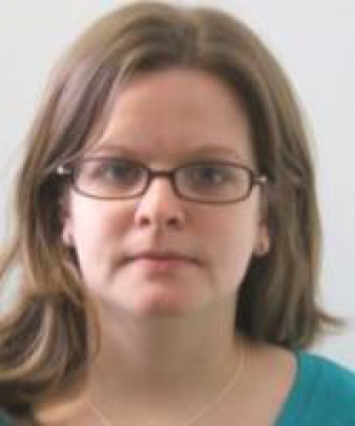
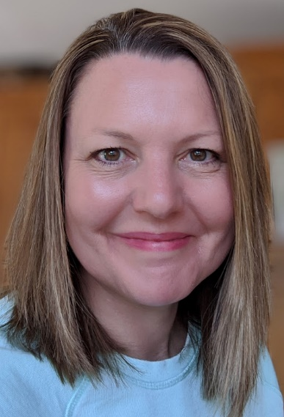
Welcome to Functional Skills English and Maths
Laura Brewin
Hannah Bishop
Tazeen Shamsi
Sophie Hayman
The English and Maths Team

Slide 3
What are Functional Skills qualifications?
The UK government developed Functional skills qualifications in English and maths for post-16 and adult learners.
The qualifications are designed to give you the literacy and numeracy skills you need for your daily life, your studies and future employment.

Slide 4
This course is right for you if..
you gained a grade 1 or 2 in GCSE English Language and/or maths
you have no qualifications in English or maths
you have passed Functional Skills English or maths at Entry Level.

Slide 5
What can I do with Functional Skills qualifications?
A pass at L1 Functional Skills English and/or maths will enable you to progress to a L2 course next year in your chosen subject.
You can progress on to GCSE English and maths at Gateway College if you pass L1 Functional Skills.
Functional Skills qualifications are recognised and valued by employers, apprenticeship providers and universities.

Slide 6
Functional Skills English at Gateway College
You will take the E3 or L1 assessment, depending on your initial assessment results and the qualifications you already have.
3 elements: Writing, Reading, Speaking and Listening
4 hours of lessons per week plus homework

Slide 7
Functional Skills English at Gateway College

Slide 8
Functional Skills Maths at Gateway College
You will take the E3 or L1 assessment, depending on your initial assessment results and the qualifications you already have.
Two assessments taken on the same day: Non -calculator and Calculator
4 hours of lessons per week plus homework

Slide 9
Any questions? Please get in touch with a member of the English and Maths team.

